Slide 1
5. Machine Learning
Continuation…..
Course Code: AFI 124

Slide 2
Previous Class
Introduction to Machine Learning,
Concepts of Learning: Supervised, Unsupervised and
Reinforcement Learning
Statistical-based Learning: Naive Bayes Model

Slide 3
Contents
Learning with Neural Networks:
Introduction: Deep Learning, Neural Network, Artificial Neural Network
Biological Neural Networks Vs. Artificial Neural Networks (ANN),
Example of Neural Network: House Price Prediction
Activation Functions: Sigmoid, Tanh, ReLu
Types of ANN: Feed-forward, Single Layered, Multi-Layered
Application of Artificial Neural Networks,
Learning Techniques in Neural Networks
Perceptron Learning,
Back - propagation Learning
Transfer Learning

Slide 4
Deep Learning
Deep learning is a broad family of techniques for machine learning in which hypotheses take the form of complex algebraic circuits with tunable connection strengths. The word “deep” refers to the fact that the circuits are typically organized into many layers, which means that computation paths from inputs to outputs have many steps.

Slide 5
Neural Network
A neural network is a series of algorithms that endeavors to recognize underlying relationships in a set of data through a process that mimics the way the human brain operates. In this sense, neural networks refer to systems of neurons, either organic or artificial in nature.

Slide 6
Artificial neural network
Artificial neural networks, usually simply called neural networks, are computing systems inspired by the biological neural networks that constitute animal brains. An ANN is based on a collection of connected units or nodes called artificial neurons, which loosely model the neurons in a biological brain.

Slide 7
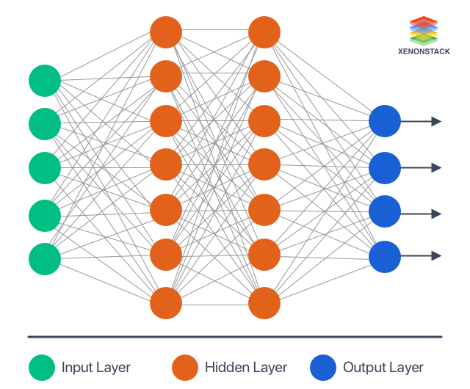
Artificial neural network Architecture
Input layer - It contains those units (Artificial Neurons) which receive input from the outside world on which the network will learn, recognize about, or otherwise process.
Output layer - It contains units that respond to the information about how it learn any task.
Hidden layer - These units are in between input and output layers. The hidden layer's job is to transform the input into something that the output unit can use somehow.

Slide 8
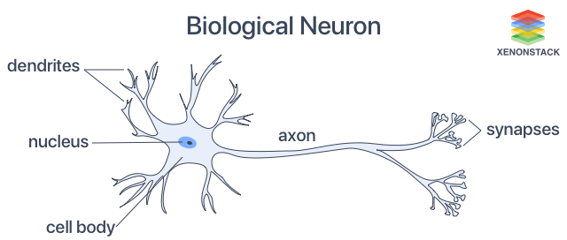
Biological Neuron
The typical nerve cell of the human brain comprises of four parts
Function of Dendrite It receives signals from other neurons.
Soma (cell body) It sums all the incoming signals to generate input.
Axon Structure When the sum reaches a threshold value, the neuron fires, and the signal travels down the axon to the other neurons.
Synapses Working The point of interconnection of one neuron with other neurons. The amount of signal transmitted depends upon the strength (synaptic weights) of the connections.

Slide 9
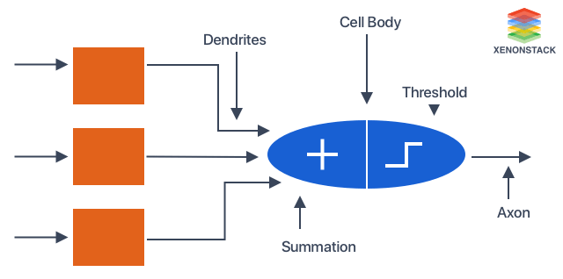
Biological Neural Networks Vs. Artificial Neural Networks (ANN)

Slide 10
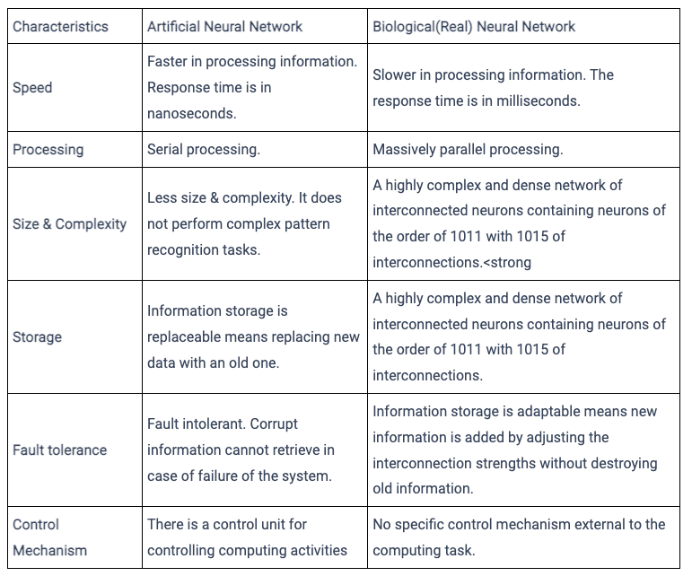
Biological Neural Networks Vs. Artificial Neural Networks (ANN)
Notes:
https://vidyaesampally1998.medium.com/artificial-neural-network-v-s-biological-neural-network-a0862d12e9a8

Slide 11
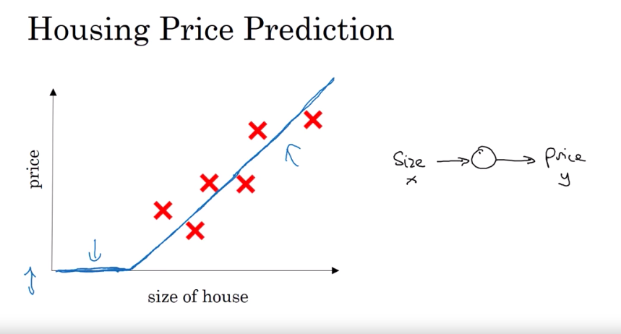
Example: House Price prediction
Notes:
6 houses r the data points.
Using linear regression, we draw a linear line and since price cant be negative, marke the line
And it looks like ReLu

Slide 12
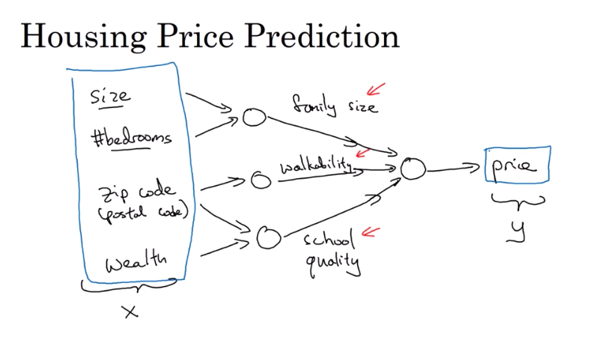

Slide 13
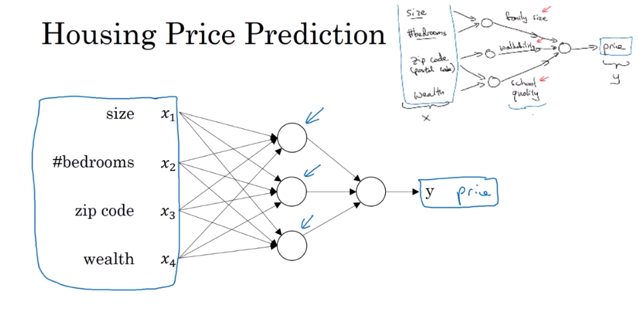

Slide 14
Activation Functions
Activation function defines the output of input.
Activation functions commonly used in deep learning systems:
(a) the logistic or sigmoid function
(b) the ReLU function
(c) the tanh function.

Slide 15
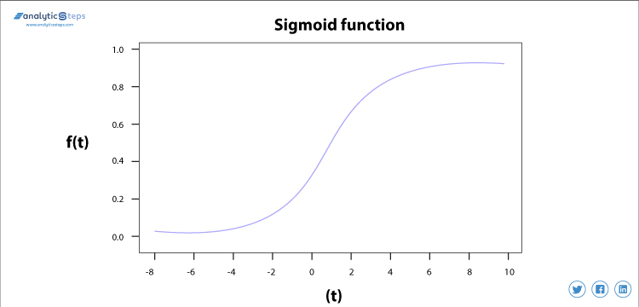
Sigmoid Functions
The sigmoid activation function is a probabilistic approach towards decision making and ranges in between 0 to 1.

Slide 16
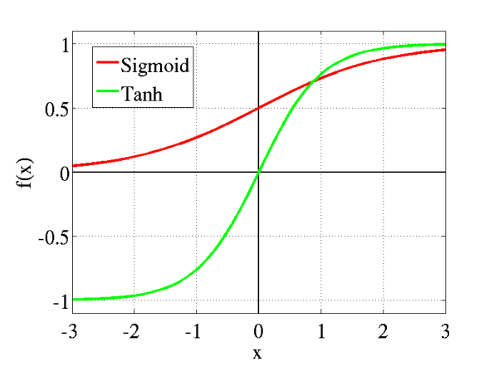
Tanh Function
Tanh is also like logistic sigmoid but better. The range of the tanh function is from (-1 to 1). tanh is also sigmoidal (s - shaped).

Slide 17
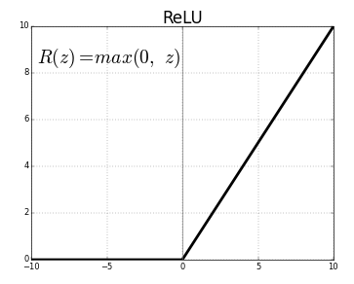
ReLU function
As you can see, the ReLU is half rectified (from bottom). f(z) is zero when z is less than zero and f(z) is equal to z when z is above or equal to zero.. The range of the ReLU function is from (0 to infinity)

Slide 18
Types of ANN
Feed-forward,
Single Layered,
Multi-Layered,
Recurrent
Notes:
https://analyticsindiamag.com/6-types-of-artificial-neural-networks-currently-being-used-in-todays-technology/

Slide 19
Types of ANN: Feedforward Neural Network
This neural network is one of the simplest forms of ANN, where the data or the input travels in one direction. The data passes through the input nodes and exit on the output nodes. This neural network may or may not have the hidden layers.
In simple words,The feed forward model is the simplest form of neural network as information is only processed in one direction. While the data may pass through multiple hidden nodes, it always moves in one direction and never backwards.

Slide 20
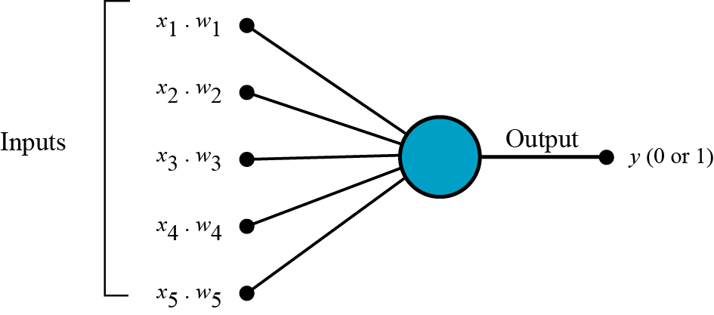
Types of ANN: Single Layer Feedforward Neural Network
In Single layer feed-forward network, the sum of the products of inputs and weights are calculated and fed to the output. The output is considered if it is above a certain value i.e threshold(usually 0) and the neuron fires with an activated output (usually 1) and if it does not fire, the deactivated value is emitted (usually -1).
A Feed Forward Neural Network is commonly seen in its simplest form as a single layer perceptron. In this model, a series of inputs enter the layer and are multiplied by the weights. Each value is then added together to get a sum of the weighted input values. If the sum of the values is above a specific threshold, usually set at zero, the value produced is often 1, whereas if the sum falls below the threshold, the output value is -1.

Slide 21
Types of ANN: Multi Layer Neural Network
A multi-layer neural network contains more than one layer of artificial neurons or nodes. They differ widely in design. It is important to note that while single-layer neural networks were useful early in the evolution of AI, the vast majority of networks used today have a multi-layer model. Basically, by adding more hidden layers / more neurons per layer you add more parameters to the model. Hence you allow the model to fit more complex functions.
Examples of Multi layer Neural Networkare:
Convolutional neural networks (CNNs)
Recurrent neural networks,
Deep networks and deep belief systems

Slide 22
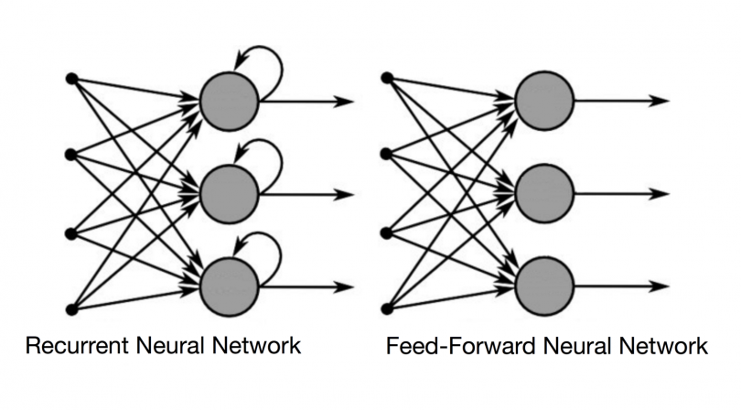
Types of ANN: Recurrent Neural Network
Recurrent neural networks (RNN) are the state of the art algorithm for sequential data and are used by Apple's Siri and and Google's voice search. It is the first algorithm that remembers its input, due to an internal memory, which makes it perfectly suited for machine learning problems that involve sequential data.
Recurrent neural networks recognize data's sequential characteristics and use patterns to predict the next likely scenario.

Slide 23
Example

Slide 24
Recurrent Neural Network(RNN) – Long Short Term Memory:
Here, the first layer is formed similar to the feed forward neural network with the product of the sum of the weights and the features. The recurrent neural network process starts once this is computed, this means that from one time step to the next each neuron will remember some information it had in the previous time-step.
This makes each neuron act like a memory cell in performing computations. In this process, we need to let the neural network to work on the front propagation and remember what information it needs for later use. Here, if the prediction is wrong we use the learning rate or error correction to make small changes so that it will gradually work towards making the right prediction during the back propagation.

Slide 25
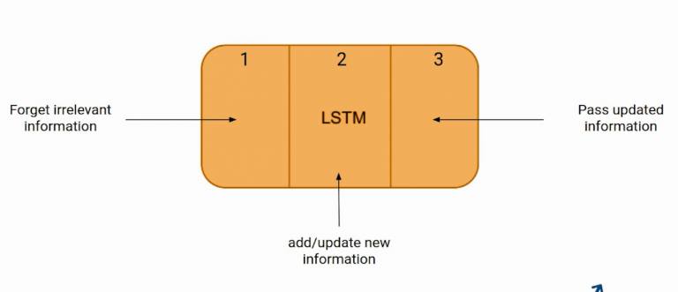
Recurrent Neural Network(RNN) – Long Short Term Memory:
The first part chooses whether the information coming from the previous timestamp is to be remembered or is irrelevant and can be forgotten.
In the second part, the cell tries to learn new information from the input to this cell.
At last, in the third part, the cell passes the updated information from the current timestamp to the next timestamp.

Slide 26
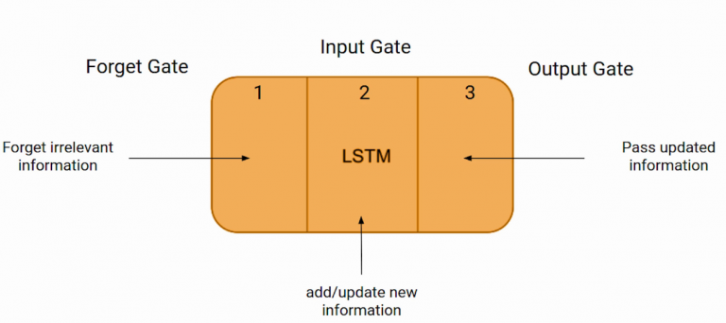
Recurrent Neural Network(RNN) – Long Short Term Memory:
These three parts of an LSTM cell are known as gates. The first part is called Forget gate, the second part is known as the Input gate and the last one is the Output gate.
Ex: Bob is a nice person. Dan, on the Other hand, is evil. The first sentence is “Bob is a nice person” and the second sentence is “Dan, on the Other hand, is evil”. It is very clear, in the first sentence we are talking about Bob and as soon as we encounter the full stop(.) we started talking about Dan.
As we move from the first sentence to the second sentence, our network should realize that we are no more talking about Bob. Now our subject is Dan. Here, the Forget gate of the network allows it to forget about it. Let’s understand the roles played by these gates in LSTM architecture.

Slide 27
Application of Artificial Neural Networks
Handwriting Recognition
Image Compression
Stock Exchange Prediction
Text Classification
Machine Translation
Speech Recognition
Facial Recognition
Notes:
https://www.xenonstack.com/blog/artificial-neural-network-applications

Slide 28
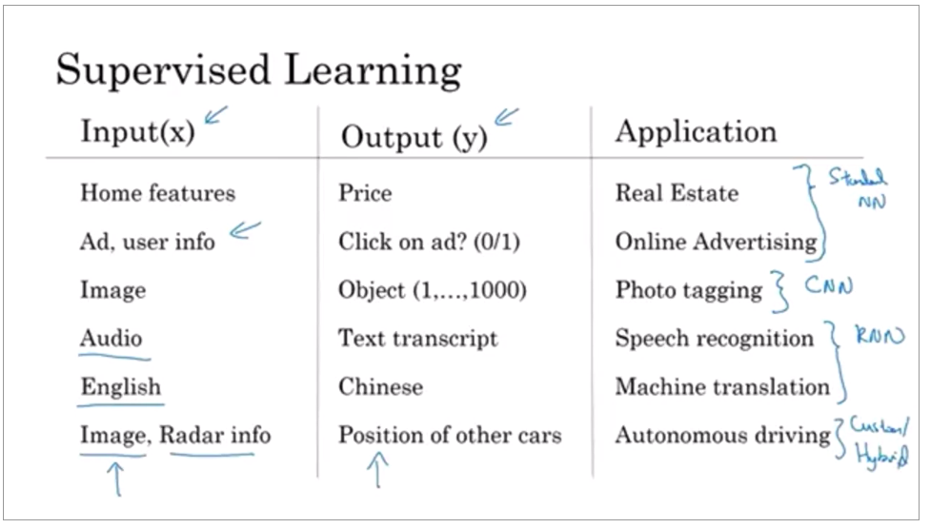
Algorithms used

Slide 29
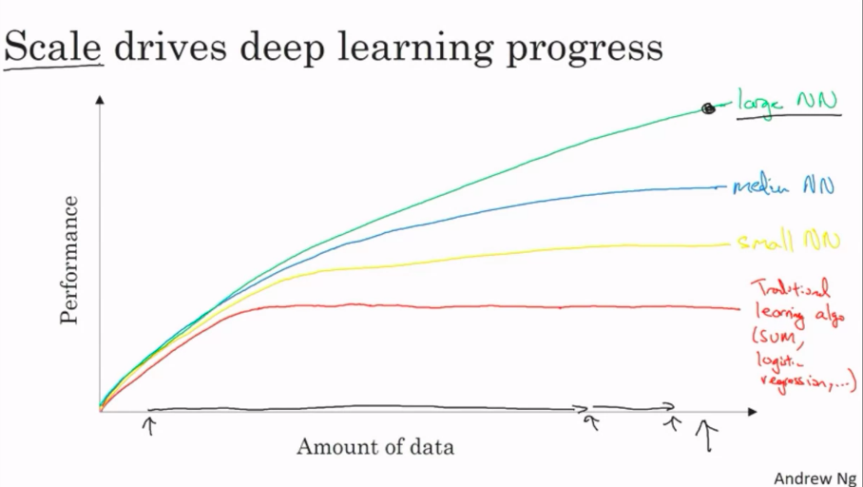

Slide 30
Learning Techniques in Neural Networks
Supervised Learning In this learning, the training data is input to the network, and the desired output is known weights are adjusted until production yields desired value.
Unsupervised Learning Use the input data to train the network whose output is known. The network classifies the input data and adjusts the weight by feature extraction in input data.
Reinforcement Learning Here, the output value is unknown, but the network provides feedback on whether the output is right or wrong. It is Semi-Supervised Learning.
Offline Learning The weight vector adjustment and threshold adjustment are made only after the training set is shown to the network. It is also called Batch Learning.
Online Learning The adjustment of the weight and threshold is made after presenting each training sample to the network.

Slide 31
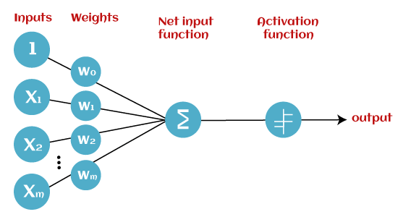
Perceptron Learning
In Machine Learning and Artificial Intelligence, Perceptron is the most commonly used term for all folks. It is the primary step to learn Machine Learning and Deep Learning technologies, which consists of a set of weights, input values or scores, and a threshold. Perceptron is a building block of an Artificial Neural Network.

Slide 32
Types of Perceptron Models
Based on the layers, Perceptron models are divided into two types. These are as follows:
Single-layer Perceptron Model: Single layer perceptron model has one hidden layer.
Multi-layer Perceptron model: Like a single-layer perceptron model, a multi-layer perceptron model also has the same model structure but has a greater number of hidden layers. The multi-layer perceptron model is also known as the Backpropagation algorithm.

Slide 33
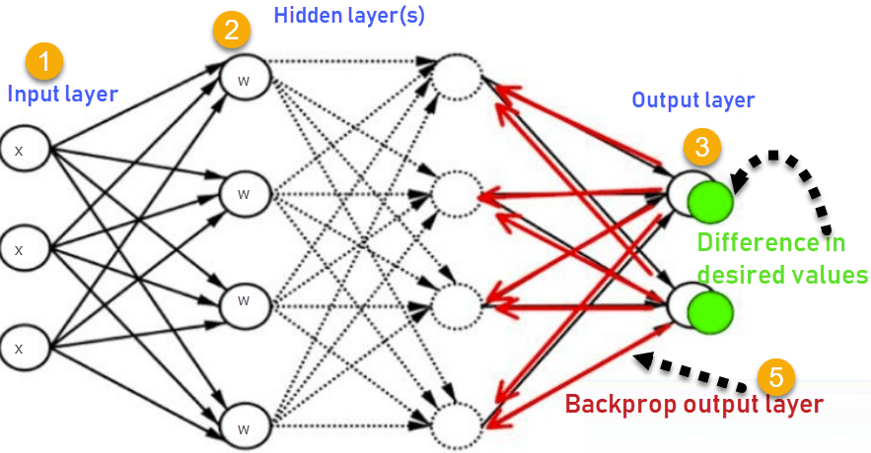
Back - propagation Learning
Backpropagation in neural network is a short form for “backward propagation of errors.” It is a standard method of training artificial neural networks. This method helps calculate the gradient of a loss function with respect to all the weights in the network.

Slide 34
Transfer Learning
Transfer learning is a machine learning method where a model developed for a task is reused as the starting point for a model on a second task.
Two common approaches are as follows:
Develop Model Approach
Pre-trained Model Approach

Slide 35
Refs
https://www.xenonstack.com/blog/artificial-neural-network-applications
https://vidyaesampally1998.medium.com/artificial-neural-network-v-s-biological-neural-network-a0862d12e9a8
https://www.tutorialspoint.com/artificial_neural_network/artificial_neural_network_applications.htm
http://neuralnetworksanddeeplearning.com/
https://www.coursera.org/learn/neural-networks-deep-learning/home/week/1
https://towardsdatascience.com/perceptron-learning-algorithm-d5db0deab975
https://www.guru99.com/backpropogation-neural-network.html
https://www.v7labs.com/blog/transfer-learning-guide#:~:text=In%20other%20words%2C%20transfer%20learning,when%20modeling%20the%20second%20task
https://analyticsindiamag.com/6-types-of-artificial-neural-networks-currently-being-used-in-todays-technology/
https://deepai.org/machine-learning-glossary-and-terms/feed-forward-neural-network .
https://www.analyticsvidhya.com/blog/2021/03/introduction-to-long-short-term-memory-lstm/

Slide 36
Study Materials
Video Course: https://www.coursera.org/learn/neural-networks-deep-learning/home/week/1
Theory Course: http://neuralnetworksanddeeplearning.com/
Brief course: https://www.tutorialspoint.com/artificial_neural_network/artificial_neural_network_applications.htm

